Slide 1
INTERNET
PROGRAMMING AND
MOBILE PROGRAMMING
Course Instructor: <Dr. VALERY K.>

Slide 2
Design and implementation of a market management system

Slide 3
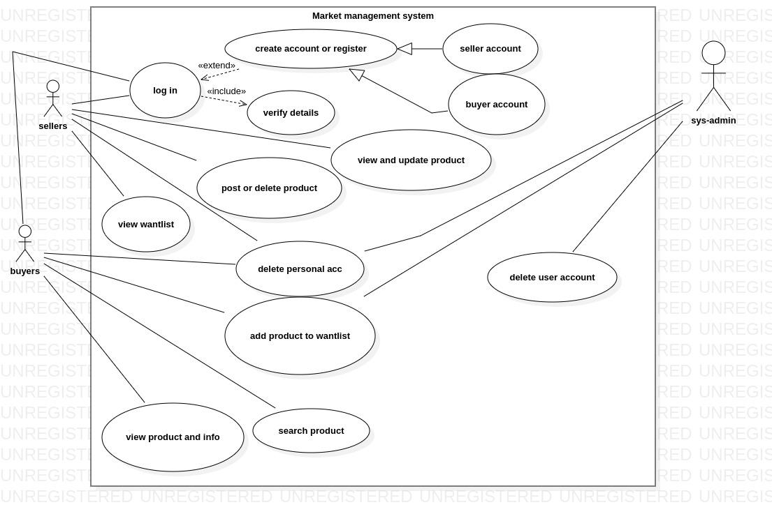
Usecase diagram

Slide 4
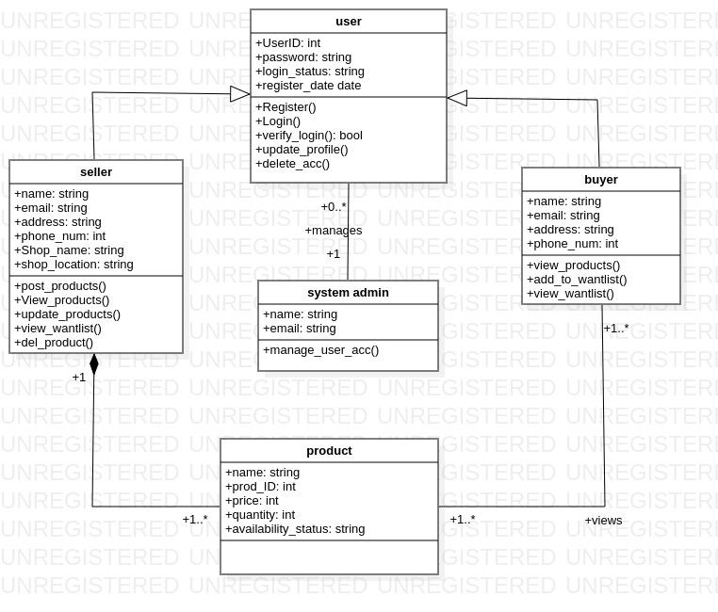
Class diagram

Slide 5
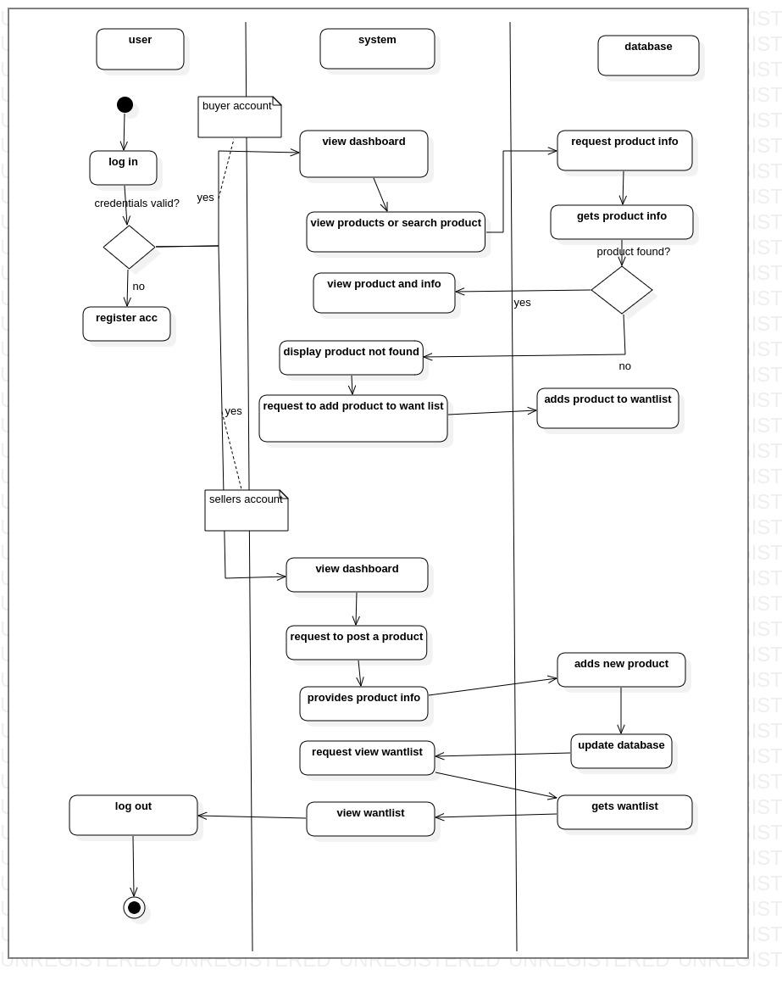
Activity diagram

Slide 6
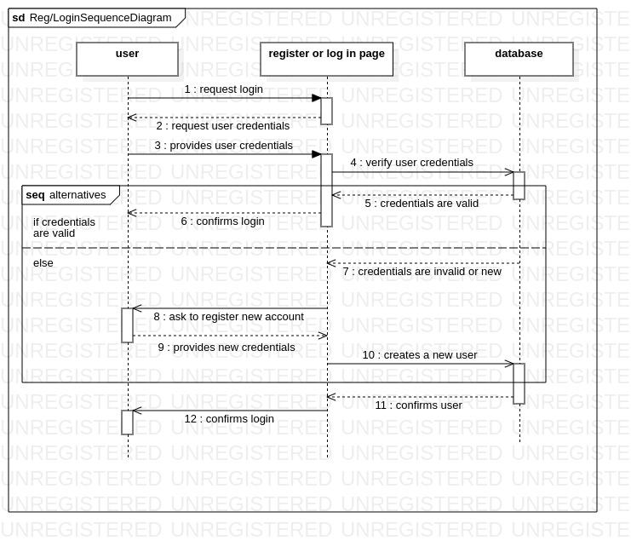
SEQUENCE DIAGRAM FOR LOGIN AND REGISTRATION

Slide 7
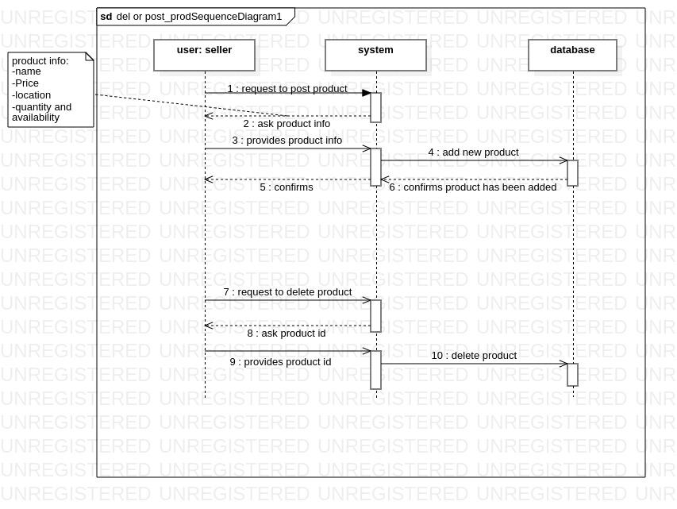
Sequence diagram for deletion and posting of products

Slide 8
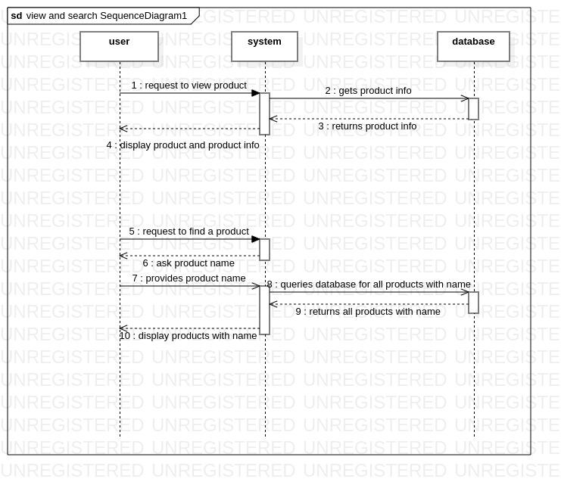
Sequence diagram for viewing and searching of product

Slide 9
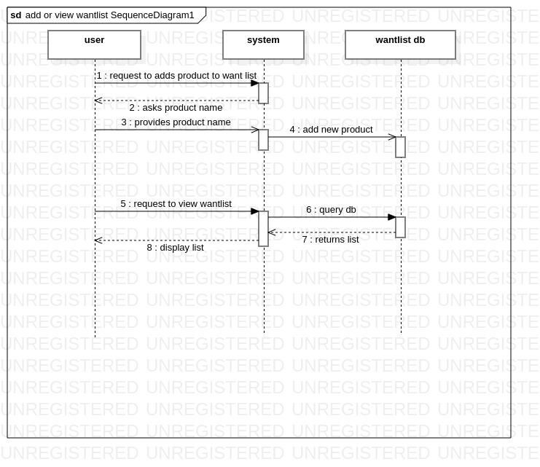
Sequence diagram of adding to or viewing from wantlist

Slide 10
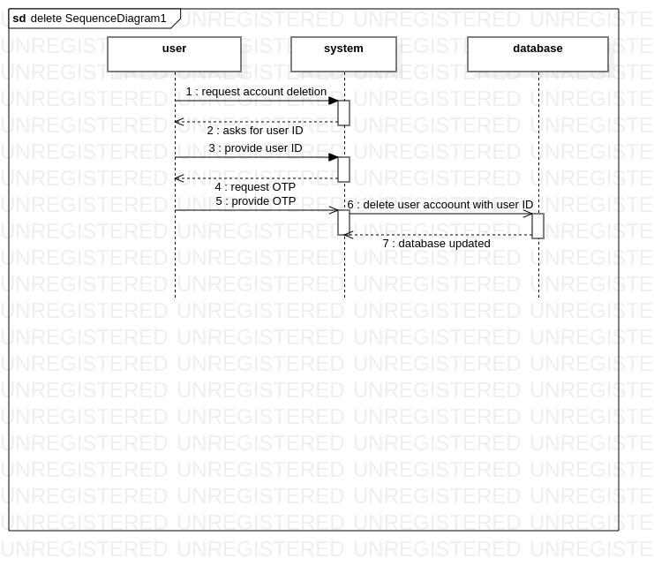
Sequence diagram for deletion of user account

Slide 11
The End
@Nnobody

